Slide 1

Mini-Tweet
A simple internet tool that mimics the functionalities and features of Twitter
Peeyush 17110053 Saumitra Sharma 17110135 Rushil Shah 17110140

Slide 2


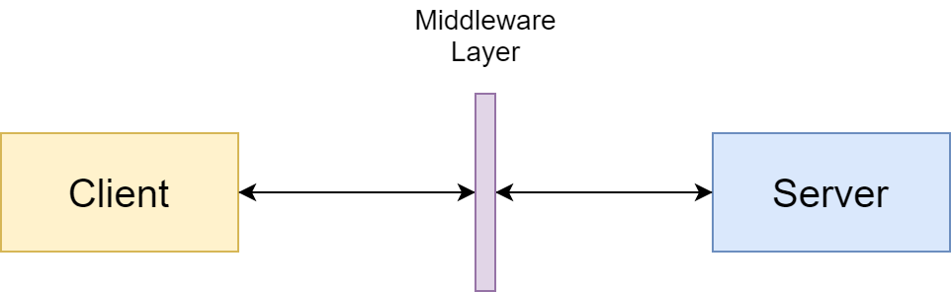
Introduction
Mini - Tweet → Miniaturized CLI version of Twitter
Two modes of design - Shell Interactive mode and Script Functionalized mode
[RESPONSE] Now following: @RobertDowneyJr
[REQUEST] Follow @RobertDowneyJr
1

Slide 3
Feature Checklist
Register New Users
Log-In existing Users
Logging Out of a Session
Get Updates → Fetches the tweets of the people the user follows (stateless)
Search Registered Users → Follow them , unfollow them and get their tweets
Post Tweet
Search Tweets with Specific Hashtags (Categorization)
Threaded Server which can handle multiple clients at the same time
Features are accessible only after the user is authenticated
The prompt for password hides the input
1

Slide 4
Database Design Details
Sqlite database (with concurrent setup)
Has four relations :
Users
handle (primary key) → username of the user (is unique)
name
Password
Tweets
Tweet_id (primary key)
Tweet_text
author
Follows
follower(foreign key: handle(Users))
gawd(foreign key: handle(Users))
Hashtags
tag
t_id (foreign key: tweet_id(Tweets))
1

Slide 5
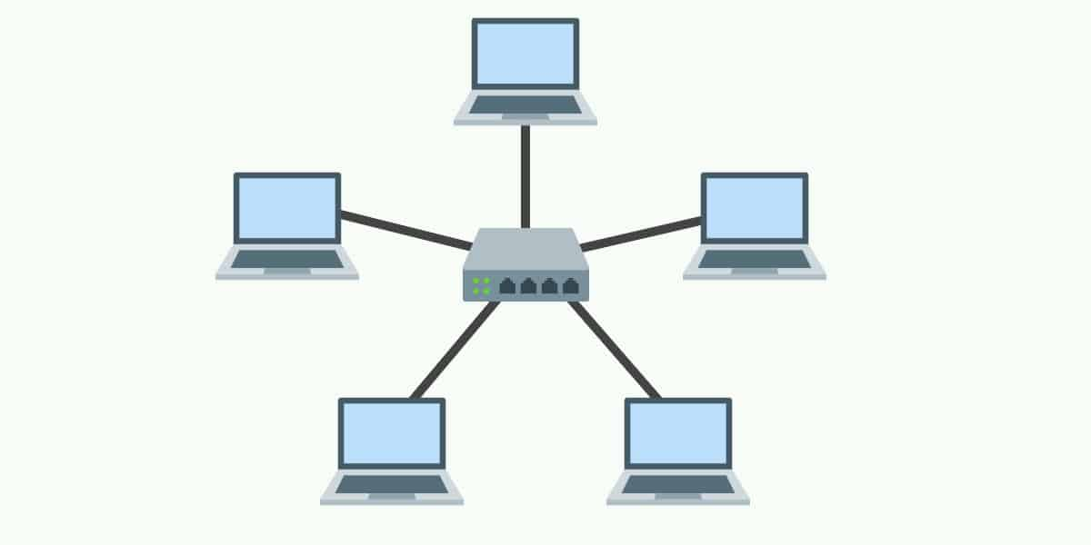
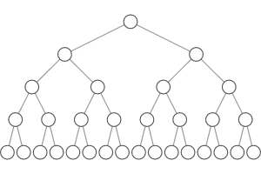
Topologies: Tested on Mininet
Linear Topology, with varying number of clients
Binary Tree Switch Topology
1

Slide 6
Novelty
A unique database design to handle the interaction of user feed, tweets, hashtags and the follows/unfollows (More on this later . . .)
A subliminal Command-Line Interface
More than one ways of testing the tool
Interactive CLI : Prompts user for input and do the needful
Via Test-Script execution : Executes functionalities via client-functions instead of interactive CLI and shows the ongoing processes by printing to STDOUT
No external dependencies
We have defined class definitions and practiced encapsulation in order to avoid the exposure of server-code/database to client
1

Slide 7
Challenges Tackled and Solved!
Managing Database to handle concurrent requests from multiple clients.
Defining and maintaining a middleware layer to communicate the client requests to the server.
Coming up with a unique database relations, and the relationships among the defined relations and their respective attributes
Encapsulating data as much as possible to minimize exposure to client
1

Slide 8
References
Concurrent operations on sqlite in python: StackOverflow
Mininet Walkthrough: http://mininet.org/walkthrough/
Image: Robert Downey Jr: https://www.elle.com/uk/fashion/celebrity-style/articles/g12487/robert-downey-jr-elle-man-of-the-week-see-the-star-of-iron-man-and-his-best-pictures/
User Image: https://www.visualpharm.com/free-icons/user-595b40b85ba036ed117da56f
Linear Topology: https://www.comparitech.com/net-admin/network-topologies-advantages-disadvantages/
Binary Tree: https://www.interviewcake.com/concept/java/binary-tree
8

